Slide 1

Predictive Maintenance
← </build_future>
Using Deep Learning for IoT Machines

Slide 2
Introduction
Predictive maintenance uses IoT sensor data to anticipate machine failures before they occur. This project applies a deep learning model to classify machine health states, leveraging real-time industrial IoT data. The proposed system significantly reduces downtime by enabling timely maintenance, enhancing operational efficiency and cost savings.

Slide 3

01
Predictive Maintenance Overview

Slide 4
Concept and
Importance
Predictive maintenance forecasts equipment faults using AI and machine learning, replacing inefficient reactive and preventive methods. It enables real-time monitoring through IoT sensors capturing key parameters like temperature and torque. This proactive strategy ensures operational continuity, reduces unexpected downtime, and optimizes maintenance costs.

Slide 5
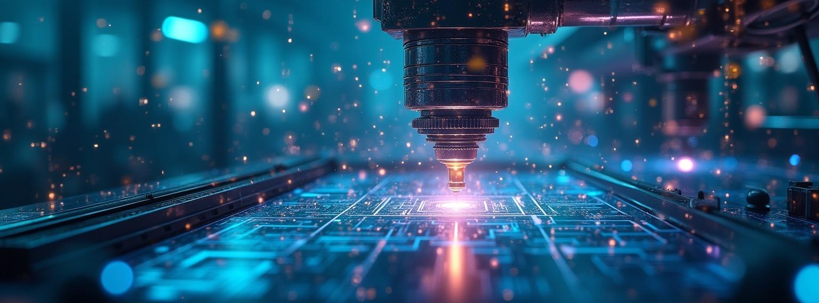
Benefits for IoT Machines
</innovation_pipeline>
IoT integration allows continuous data collection from multiple sensors, feeding deep learning models to detect early warning signs. This results in high accuracy fault prediction, supporting smart factories. Benefits include minimizing machine breakdowns, improving production efficiency, and enabling automated decision-making in Industry 4.0 environments.

Slide 6
Challenges and
Considerations
Your Name
Your Project
DD/MM/20XX
Deploying predictive maintenance in industrial IoT systems faces challenges such as handling noisy and imbalanced datasets, ensuring data quality, and managing real-time data streams. The complexity of sensor data requires advanced preprocessing including cleaning, normalization, and encoding. Additionally, the interpretability of deep learning models remains critical for operator trust, while deployment environments demand both low latency and energy-efficient solutions.

Slide 7

Deep Learning Models and Techniques
</innovation_pipeline>
The system employs a Feed-Forward Neural Network (FNN) tailored for binary classification, transforming sensor data input into predictions of machine health. Other architectures such as CNN, LSTM, and hybrid CNN-LSTM models enhance spatial and temporal data analysis. Recent trends include attention mechanisms and transfer learning to improve accuracy, interpretability, and adaptability for real-world industrial applications.

Slide 8
Data Collection and Feature
Extraction
Data is collected from IoT sensors measuring key parameters like air temperature, process temperature, torque, rotational speed, and tool wear. The dataset undergoes cleaning to remove inconsistencies, encoding of categorical features, and normalization to ensure uniform influence across variables. This post-processed data efficiently trains deep learning models to detect early signs of machine failure.

Slide 9
Implementation and Performance
Metrics
The model was trained on the AI4I 2020 dataset, achieving a training accuracy of 99.9% and testing accuracy of 99.8%. Evaluation metrics include perfect precision (100%), high recall (97%), and an F1-score of 98%, demonstrating strong reliability in failure detection and minimal false alarms. Training showed excellent convergence without overfitting, validating the model’s generalization capability.

Slide 10
Conclusions
This deep learning-based predictive maintenance framework leverages IoT sensor data for timely machine failure prediction with outstanding accuracy and robustness. By automating fault detection and maintenance scheduling, it transforms industrial operations toward Industry 4.0 standards, reducing downtime and operational costs. Future enhancements include integrating advanced temporal models, edge deployment, explainable AI, and system integration for comprehensive smart maintenance.

Slide 11
Thank
YOU

